Slide 1
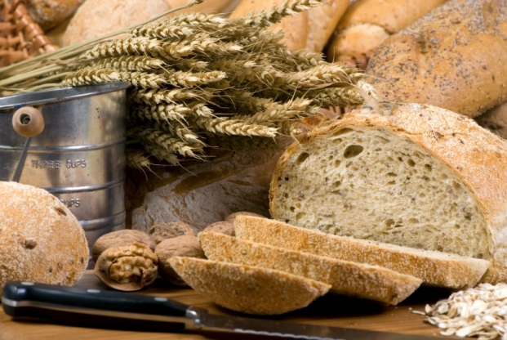
Macronutrients
© Livestock & Meat Commission for Northern Ireland 2015

Slide 2
Learning objectives
Identify valuable sources of carbohydrate, protein and fat, and explain the functions of each nutrient.
Explain the effects on health of deficiency and excess of each nutrient.
© Livestock & Meat Commission for Northern Ireland 2015

Slide 3
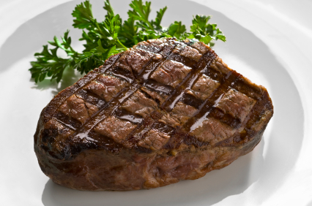
Macronutrients
Food provides the body with a range of nutrients, some of which provide energy, while others are essential for growth and maintenance of the body.
Carbohydrate, protein and fat are known as macronutrients, and provide the body with energy.
Macronutrients are measured in grams (g).
© Livestock & Meat Commission for Northern Ireland 2015

Slide 4
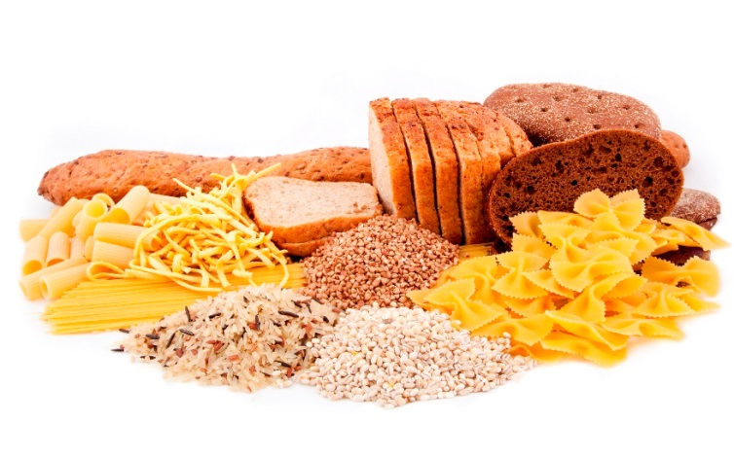
Carbohydrates
Carbohydrates are a key component of the diet.
There are two types of carbohydrate which provide the body with energy – sugars and starches.
Dietary fibre is also a form of carbohydrate and is important for digestive health, however this is not digested to provide the body with energy.
Starchy carbohydrate is an important source of energy.
1g of carbohydrate provides 4 kcal (17kJ).
© Livestock & Meat Commission for Northern Ireland 2015

Slide 5
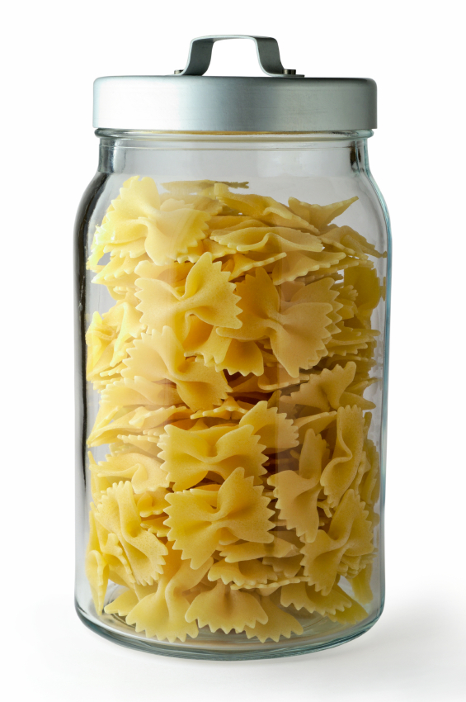
Classification of carbohydrates
Carbohydrates are compounds of carbon, hydrogen and oxygen.
They are commonly classified by their structure.
They can be divided into three main groups, according to the size of the molecule.
© Livestock & Meat Commission for Northern Ireland 2015

Slide 6
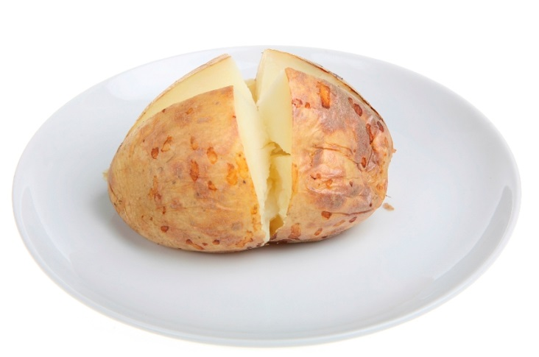
Classification of carbohydrates
Monosaccharides are the simplest carbohydrate molecule. Examples include:
Glucose
Fructose
Galactose
Disaccharides are formed when two monosaccharides join together, with the removal of one molecule of water. Examples include:
Sucrose (glucose + fructose)
Lactose (glucose + galactose)
Maltose (glucose + glucose)
Monosaccharides and disaccharides are collectively termed as ‘sugars’.
© Livestock & Meat Commission for Northern Ireland 2015

Slide 7
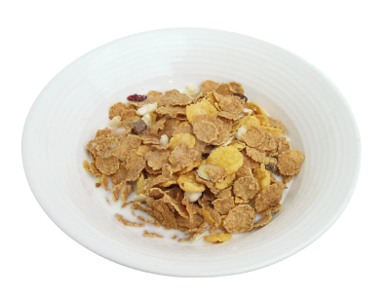
Classification of carbohydrates
Polysaccharides are made up of many monosaccharide molecules joined together.
Examples include:
Starch;
Glycogen;
Components classified as dietary fibre such as beta glucan and pectin.
© Livestock & Meat Commission for Northern Ireland 2015

Slide 8
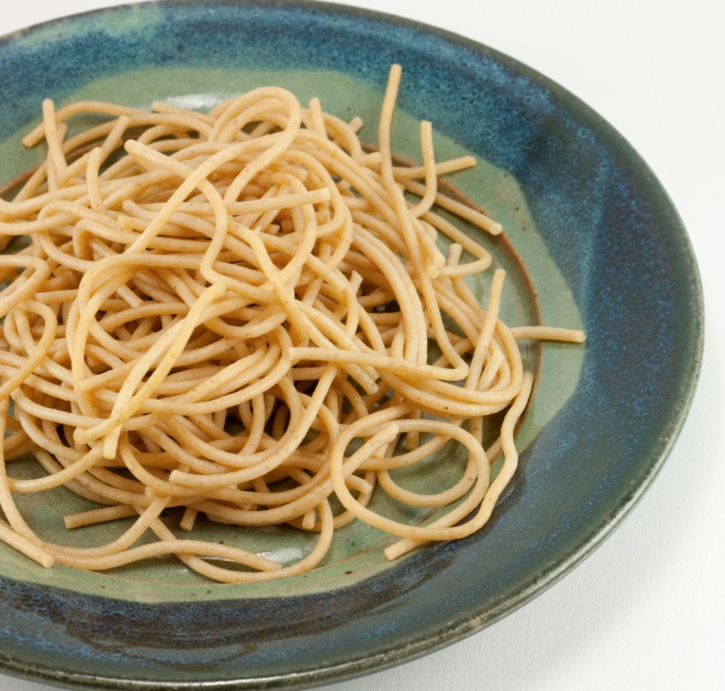
Sources of carbohydrate
Starch can be found in food such as bread, potatoes, rice, pasta, breakfast cereals and other starchy foods.
What other examples of starchy foods can you think of?
The main sources of carbohydrate in the diet in Northern Ireland are cereal and cereal products.
© Livestock & Meat Commission for Northern Ireland 2015

Slide 9
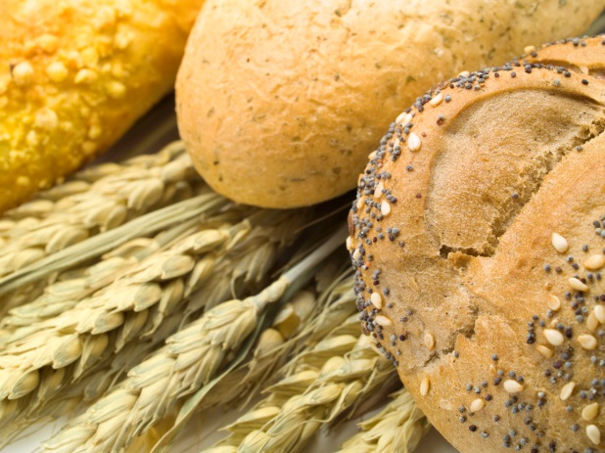
Sources of carbohydrate
© Livestock & Meat Commission for Northern Ireland 2015

Slide 10
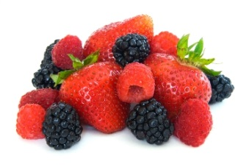
Sources of carbohydrate
Sugars can be divided into intrinsic and extrinsic sugars.
Intrinsic sugars
These are found within the cellular structure of foods, e.g. sugars in whole fruits and vegetables.
Extrinsic sugars
These are not bound to a cellular structure, e.g. the lactose in dairy products. Other examples include honey, confectionary, fruit juices and table sugar, and are known as non-milk extrinsic sugars (NMES).
© Livestock & Meat Commission for Northern Ireland 2015

Slide 11
Sources of carbohydrate
Free sugars
‘Free sugars’ comprises all monosaccharides and disaccharides added to foods by the manufacturer, cook or consumer, plus sugars naturally present in honey, syrups and unsweetened fruit juices.
Under this definition lactose (the sugar in milk) when naturally present in milk and milk products and the sugars contained within the cellular structure of foods (particularly fruits and vegetables) are excluded.
Free sugars – from the SACN Carbohydrate and Health report, 2015
© Livestock & Meat Commission for Northern Ireland 2015

Slide 12
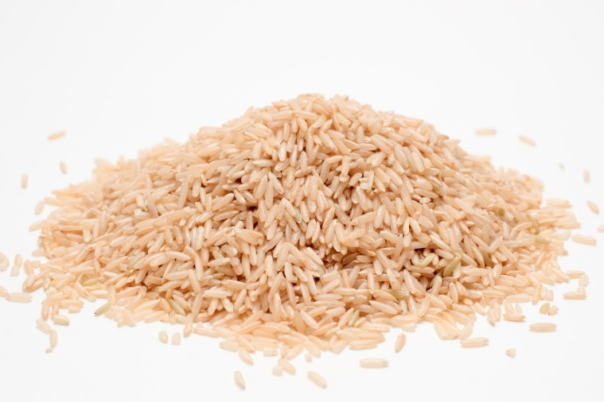
Sources of carbohydrate
Which of these foods do you think contains the largest amount of carbohydrate per 100g?
Food (per 100g)
Brown rice, boiled
Baked potato
Banana
Wholemeal bread
Red lentils, cooked
Carbohydrate (g)
32.1
18.0
23.2
42.0
17.5
© Livestock & Meat Commission for Northern Ireland 2015

Slide 13
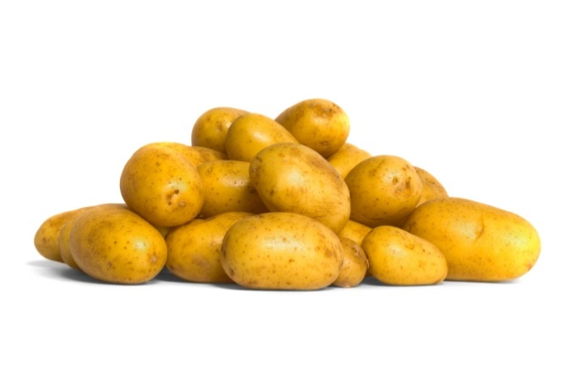
Functions of carbohydrate
The body’s tissues require a constant supply of glucose, which is used as a fuel.
A constant supply is required as only a small amount can be stored in the body, in the form of glycogen.
A small amount can also be synthesised in the body from protein. This is not the best use of protein, as it should mainly be used for growth and repair of body tissues.
© Livestock & Meat Commission for Northern Ireland 2015

Slide 14
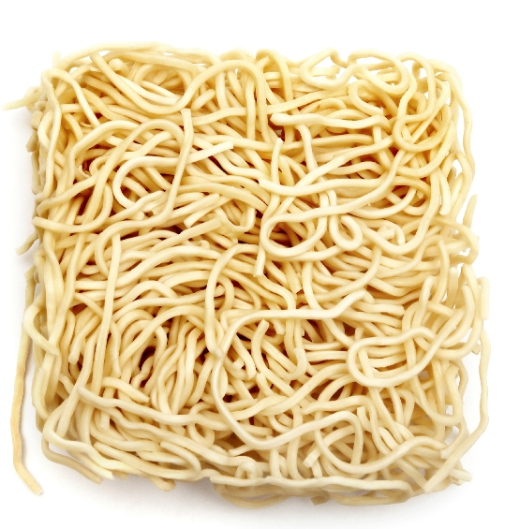
Functions of carbohydrate
Carbohydrate is the only dietary source of glucose, and provides the body with 4kcal/17kJ per gram.
*Dietary fibre provides a small amount of energy as it is digested in the large bowel by the resident bacteria into short chain fatty acids. This provides the body with 2kcal/8kJ per gram.
© Livestock & Meat Commission for Northern Ireland 2015

Slide 15
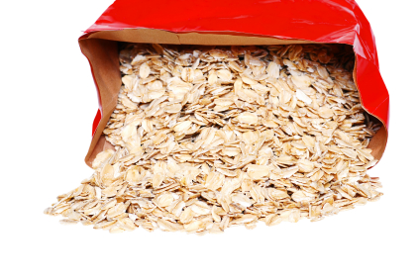
Recommendations on carbohydrate
It is recommended that meals are based on starchy foods.
Carbohydrates should provide around 50% of dietary energy (starch and sugars combined).
The average intake, across the UK population, of free sugars should not exceed 5% of total dietary energy intake.
© Livestock & Meat Commission for Northern Ireland 2015

Slide 16
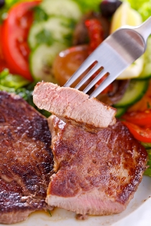
Protein
Proteins are large molecules, made up of a series of amino acids.
Amino acids are the building blocks of proteins.
There are about 20 different amino acids commonly found in plant and animal proteins.
For adults, 8 of these have to be provided by foods in the diet, and are therefore defined as ‘essential’ or ‘indispensable’ amino acids.
These are leucine, isoleucine, valine, threonine, methionine, phenylalanine, tryptophan, lysine.
© Livestock & Meat Commission for Northern Ireland 2015

Slide 17
Amino acids
Children are unable to synthesise sufficient quantities of the amino acids arginine, histidine, cysteine, glycine, tyrosine, glutamine and proline, so these are also considered to be essential, and referred to as ‘conditionally essential’.
The remaining amino acids do not need to be provided by the diet.
The body can make some amino acids itself – these are known as ‘non-essential’ or ‘dispensable’ amino acids.
© Livestock & Meat Commission for Northern Ireland 2015

Slide 18
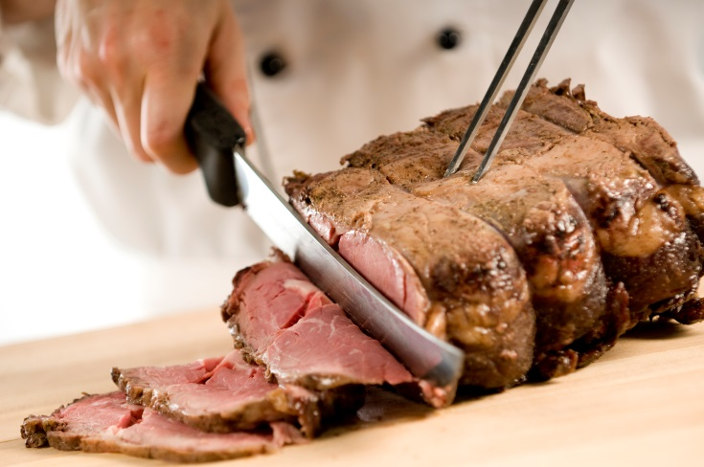
Amino acids
The amount of essential amino acids that are present determines the biological value of the protein.
Proteins derived from an animal source provide good amounts of the essential amino acids, and therefore have a higher biological value than proteins derived from a plant source.
Why do you think this is the case?
The pattern of amino acids in animal cells is similar to the pattern in human cells.
© Livestock & Meat Commission for Northern Ireland 2015

Slide 19
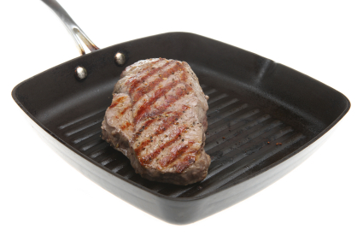
Sources of protein
Animal sources:
meat;
poultry;
fish;
eggs;
milk;
dairy foods.
Plant sources:
soya;
nuts;
seeds;
pulses, e.g. beans, lentils;
mycoprotein.
The main source of protein in the diet of adults in Northern Ireland is meat and meat products.
© Livestock & Meat Commission for Northern Ireland 2015

Slide 20
Protein sources
© Livestock & Meat Commission for Northern Ireland 2015

Slide 21
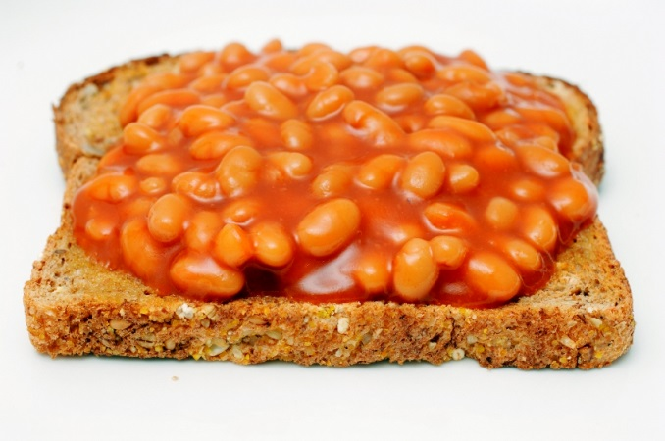
Protein complementation
Different proteins can complement one another in their amino acid pattern.
When two foods providing vegetable protein are eaten at a meal, such as a cereal (e.g. bread) and pulses (e.g. baked beans), the amino acids of one protein may compensate for the limitations of the other, resulting in a combination of higher biological value.
This is known as protein complementation.
© Livestock & Meat Commission for Northern Ireland 2015

Slide 22
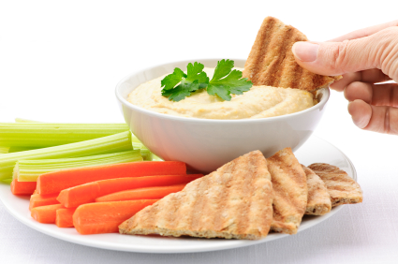
Protein complementation
If vegetarians and vegans eat a variety of vegetable proteins in combination, there is no reason why the quality of protein cannot be as good as in a diet consuming animal proteins.
Can you think some of some examples of protein complementation?
rice and peas;
beans on toast;
hummus and pitta bread;
bean chilli served with rice.
© Livestock & Meat Commission for Northern Ireland 2015

Slide 23
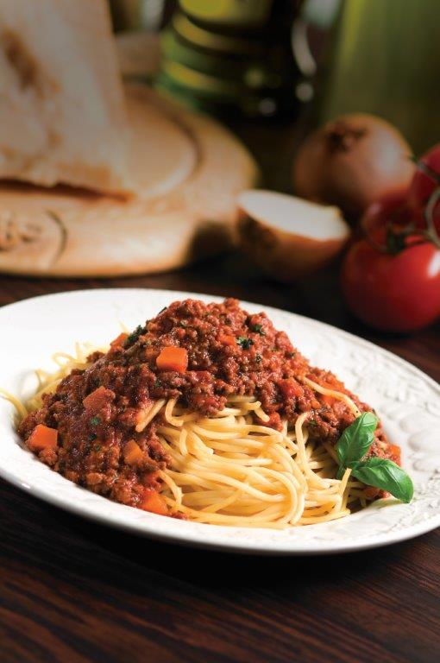
Protein function
Protein is required for growth and repair of the body and to maintain good health.
Protein forms structural and functional elements of body cells, and is needed for growth in muscle mass and the maintenance of muscle mass and normal bones.
Protein is involved in various metabolic reactions, including signalling functions.
© Livestock & Meat Commission for Northern Ireland 2015

Slide 24
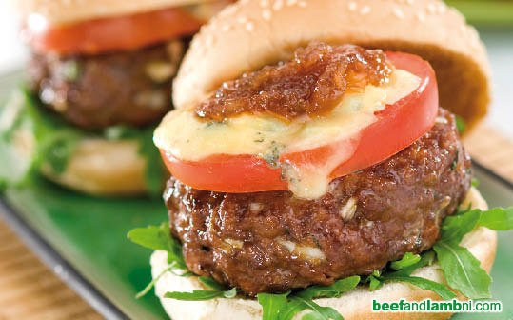
Protein function
Protein also provides energy – 1 gram provides 4kcal/17kJ.
Protein is the second most abundant compound in the body, following water. A large proportion of protein is in muscle (43% on average). Protein is also present in skin (15%) and blood (16%).
The amount of protein we need changes during a lifetime.
© Livestock & Meat Commission for Northern Ireland 2015

Slide 25
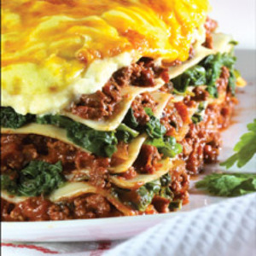
Recommendations on protein
It is recommended that adults and children eat a moderate amount of protein food each day.
If protein comes mainly from plant sources, it is important to make sure that different types are eaten.
The Reference Nutrient Intake (RNI) is set at 0.75g of protein per kilogram bodyweight per day for adults. This equates to around 56g per day of protein for the average man and 45g per day of protein for the average women.
For people not on a weight-reducing diet, around 15% of dietary energy should come from protein.
© Livestock & Meat Commission for Northern Ireland 2015

Slide 26
Fat
Fat is made up of different types of fatty acids attached to a glycerol molecule backbone. This is called a triglyceride.
Depending on their chemical structure, fatty acids are often classified as:
saturated fatty acids (also known as ‘saturated fat’ or ‘saturates’);
monounsaturated fatty acids;
polyunsaturated fatty acids (omega-3, omega-6 and omega-9);
trans fatty acids.
© Livestock & Meat Commission for Northern Ireland 2015

Slide 27
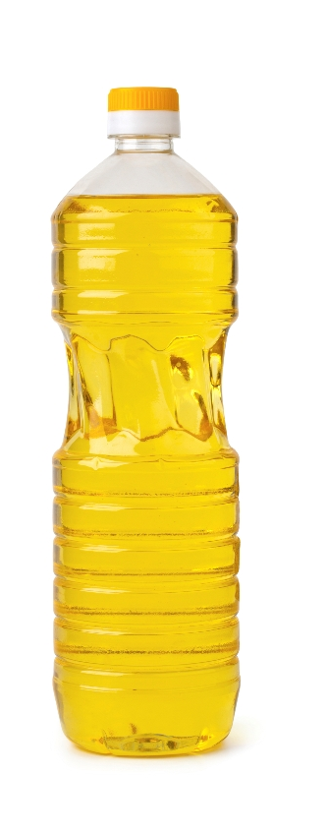
Fat
The structure of the fatty acids determines:
their effect on our health;
their characteristics, e.g. melting point and digestibility.
Fat is found in most food groups and fat-containing foods usually provide a range of different fatty acids.
Despite this, foods are often categorised by the dominant type of fatty acid, so even foods with a high saturated fat content also provide some monounsaturates and polyunsaturates.
© Livestock & Meat Commission for Northern Ireland 2015

Slide 28
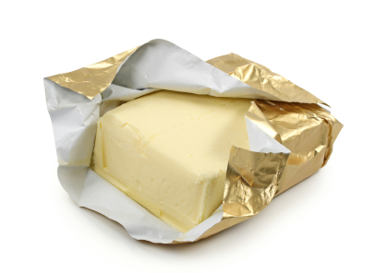
Fat
For example, butter is often described as a ‘saturated fat’ because it has more saturated fatty acids than unsaturated fatty acids.
Most vegetable oils are described as ‘unsaturated fats’ as they have more mono- and polyunsaturated fatty acids than saturated.
Most saturated fats are solid at room temperature and tend to come from animal sources.
Most unsaturated fats are liquid at room temperature and are usually vegetable fats.
© Livestock & Meat Commission for Northern Ireland 2015

Slide 29
Saturated fat
Eating too many foods high in fat, especially saturated fat, can have adverse effects on health.
This is associated with raised blood cholesterol level, which is one of the risk factors for coronary heart disease.
Diets high in saturated fatty acids are associated with the development of insulin resistance and abnormal blood fat levels, which are associated with increased risk of type 2 diabetes.
Foods high in saturated fat include:
Butter, hard cheese, biscuits, cakes, pastries, chocolate, fatty cuts of meat, meat products e.g. sausages and salami, and skin of poultry.
© Livestock & Meat Commission for Northern Ireland 2015

Slide 30
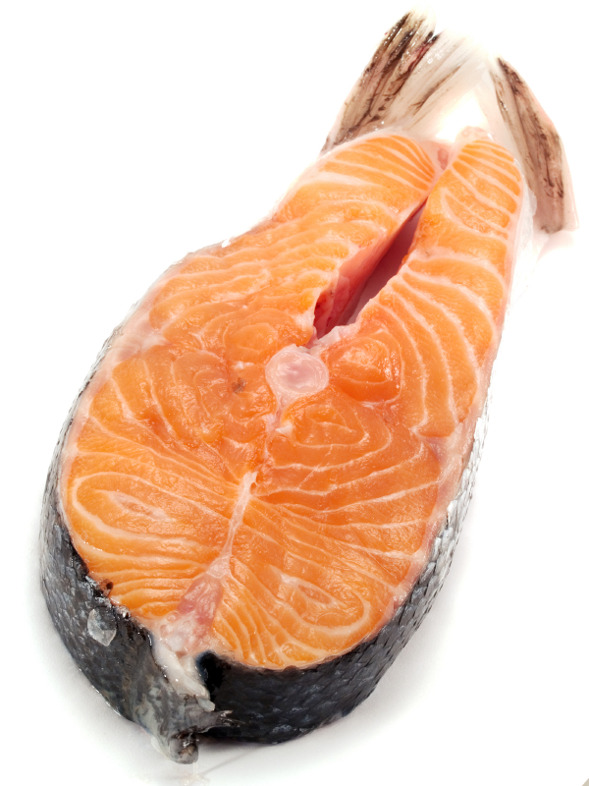
Mono- and polyunsaturated fat
Mono - and polyunsaturated fats are associated with reduced blood cholesterol levels.
A role in heart health has been established for dietary sources of the omega-3 fatty acids present in oily fish.
© Livestock & Meat Commission for Northern Ireland 2015

Slide 31
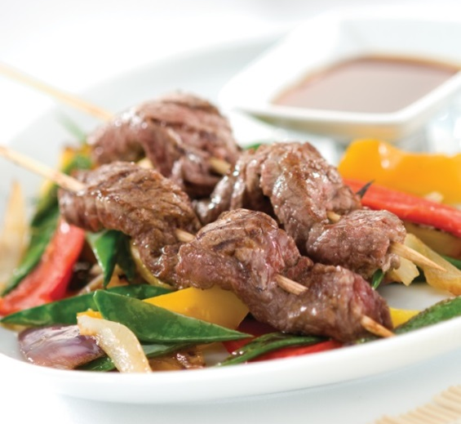
Sources of total fat
Data from NDNS RP Years 1-4 for Northern Ireland (2008/09-2011/12)
http://www.food.gov.uk/northern-ireland/researchni/ndns-ni
© Livestock & Meat Commission for Northern Ireland 2015
Notes:
Meat and meat products – 26%
Of which:
Bacon and ham – 3%
Beef, veal and dishes – 5%
Lamb and dishes – 1%
Pork and dishes – 2%
Coated chicken and turkey – 2%
Chicken, turkey and dishes – 5%
Burgers and kebabs – 2%
Sausages – 5%
Meat pies and pastries – 3%
Other meat, meat products and dishes – 0%
(Percentage figures are rounded-up for individual foods.)

Slide 32
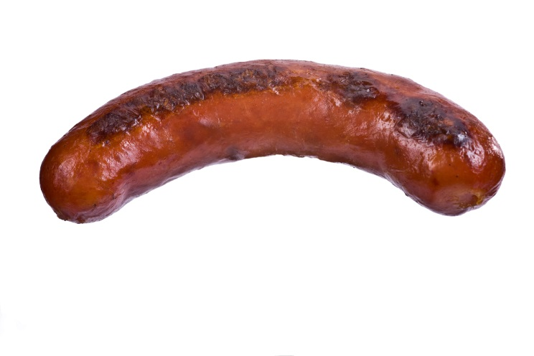
Sources of saturated fat in the diet of adults (19-64 years) in Northern Ireland
Meat and meat products – 26%
Cereal and cereal products – 20%
Milk and milk products – 19%
Eggs and egg dishes – 3%
Fat spreads – 13%
Vegetables and potatoes – 6%
Fish and fish dishes – 2%
Vegetables and potatoes – 6%
Savoury snacks – 2%
Nuts and seeds – 1%
Sugars, preserves and confectionary – 5%
Miscellaneous – 3%
Data from NDNS RP Years 1-4 for Northern Ireland (2008/09-2011/12)
http://www.food.gov.uk/northern-ireland/researchni/ndns-ni
© Livestock & Meat Commission for Northern Ireland 2015
Notes:
Meat and meat products – 26%
Of which:
Bacon and ham – 3%
Beef, veal and dishes - 5%
Lamb and dishes – 1%
Pork and dishes – 2%
Coated chicken and turkey – 1%
Chicken, turkey and dishes – 3%
Burgers and kebabs – 2%
Sausages – 5%
Meat pies and pastries – 3%
Other meat, meat products and dishes – 1%

Slide 33
Functions of fat
Fat is a concentrated source of energy. 1 gram of fat provides 9kcal (37kJ).
Fat is the carrier for fat-soluble vitamins A,D, E and K.
Fat is a component of hormones which control biochemical reactions within cells.
Fat provides cushioning for the major organs in the body.
© Livestock & Meat Commission for Northern Ireland 2015

Slide 34
Functions of fat
The body can synthesise all the fatty acids it needs except for alpha linolenic acid (omega-3) and linoleic acid (omega-6).
These are the essential fatty acids and must be provided in the diet. From these fatty acids, the body can make other fatty acids which are important for health.
© Livestock & Meat Commission for Northern Ireland 2015

Slide 35
Recommendations on fat
Total fat intake should not make up more than 35% of food energy. No more than 11% of food energy should come from saturated fatty acids.
Average total fat intake of adults in Northern Ireland is 35.6%.
Intakes of saturated fat for men and women are 13.3% and 13.0% of food energy respectively.
Both of these intakes are currently too high.
© Livestock & Meat Commission for Northern Ireland 2015

Slide 36
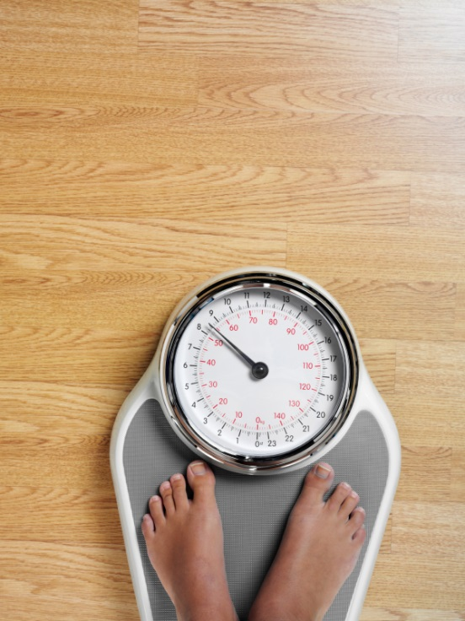
Health effects of macronutrients
Obesity
Cardiovascular disease
Diabetes
© Livestock & Meat Commission for Northern Ireland 2015

Slide 37
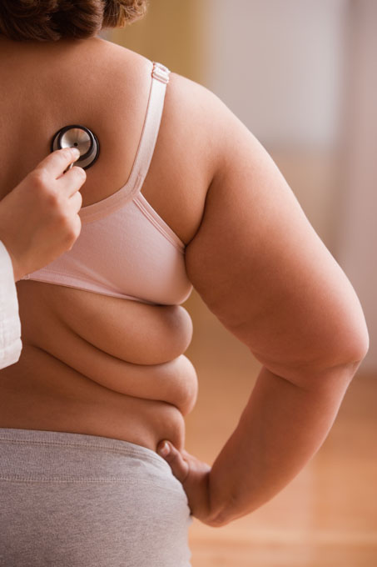
Obesity
Obesity is a condition in which abnormal or excessive fat accumulation in adipose tissue impairs health.
It is often the result of energy intake exceeding energy expenditure over a long period of time.
It is defined in adults as a body mass index (BMI) above 30.
In Northern Ireland in 2013/14, almost a quarter of adults (25%) and 7% of children were obese.
Overweight and obesity are associated with an increased risk of developing some cancers, cardiovascular disease and type 2 diabetes.
© Livestock & Meat Commission for Northern Ireland 2015

Slide 38
Cardiovascular disease
Cardiovascular disease (CVD), which includes coronary heart disease (CHD) and stroke, is a common cause of death and ill-health in the UK.
The two main events that lead to CVD are atherosclerosis and thrombosis.
Atherosclerosis causes narrowing of the blood vessels, which can result in reduced flow of blood to the heart and may cause chest pain, which is known as angina.
© Livestock & Meat Commission for Northern Ireland 2015

Slide 39
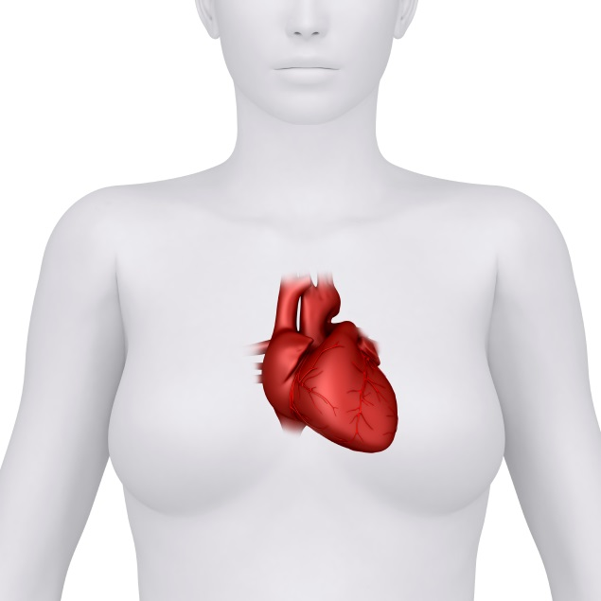
Cardiovascular disease
Thrombosis occurs when a large clot forms in the blood vessel, when cells in the blood called platelets stick together. If this stops the blood supply from reaching the heart, it leads to a heart attack. If it stops the blood from reaching the brain, this leads to a stroke.
© Livestock & Meat Commission for Northern Ireland 2015

Slide 40
Diabetes
Diabetes has become a major threat to public health. It is one of the major causes of premature illness and death in most countries, including the UK, and is becoming more common.
There are two main types – type 1 and type 2.
Type 1 diabetes is also known as insulin dependent diabetes, and is an auto-immune condition in which the body’s immune system turns against itself, causing permanent damage to particular cells in the pancreas that produce insulin. This results in insulin production ceasing, therefore in order to manage type 1 diabetes insulin must be injected and a healthy diet must be consumed.
© Livestock & Meat Commission for Northern Ireland 2015

Slide 41
Diabetes
Type 2 diabetes is also known as non-insulin dependent diabetes occurs when the body does not produce enough insulin, or the insulin which is produced does not work properly , which is known as insulin resistance. This type of diabetes is typically associated with being overweight or obese. The two main approaches to treatment of type 2 diabetes is diet modification and physical activity.
© Livestock & Meat Commission for Northern Ireland 2015

Slide 42
Diabetes
Diabetes is on the increase in Northern Ireland as it is worldwide.
The number of people living with Type 1 and Type 2 diabetes has increased by 33 per cent in Northern Ireland during the last five years compared to just 25 per cent in England, 20 per cent in Wales and 18 per cent in Scotland.
If not properly managed and treated diabetes can lead to serious complications such as heart disease, stroke, blindness, amputation and kidney failure.
© Livestock & Meat Commission for Northern Ireland 2015

Slide 43
Summary
Carbohydrate, protein and fat are known as the macronutrients.
Macronutrients provide energy in varying amounts.
All of the macronutrients are important for different functions.
There are government recommendations on the quantities we require of each.
© Livestock & Meat Commission for Northern Ireland 2015

Slide 44
Acknowledgement
For further information, go to: www.food4life.org.uk
© LMC 2015
© Livestock & Meat Commission for Northern Ireland 2015

