Slide 1
Write the title (Is it melting?) the date, your name, and your group members names in your lab notebook.
Beginning Thoughts
Make a chart in the beginning thoughts section of your notebook
Melting | Not Melting
Place the following events under the correct heading
Putting a bowl of frozen ice cream in the sun.
Sawing wood to make sawdust
Dissolving salt in water
Adding a LifeSavers candy to a glass of warm water
Water evaporating from a pan.
Dissolving a sugar cube in a cup of hot tea.
Pouring vinegar on baking soda.
Sucking on a lollipop or other hard candy
Holding an ice cube in your hand
Write a detailed definition of melting.
What is matter?
What are the forms of matter? (give an example of each form)

Slide 2
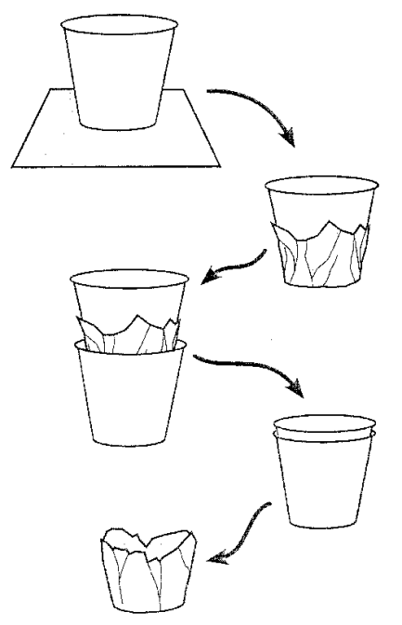
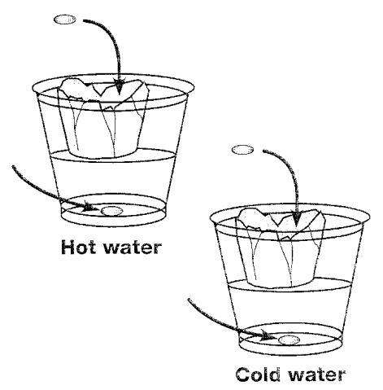
Procedure
Place a paper cup in the center of a foil square. Bring the foil up around the edges of the cup.
Place the foil-wrapped cup inside a second cup. Push gently but firmly all the way down.
Remove the foil cup. The foil cup will float on the water in a plastic cup.
Repeat the procedure to make a second aluminum foil cup.
Fill one plastic cup ½ full of hot water and one plastic cup ½ full of cold water
Put the aluminum foil cup in each cup of water
Get four candies, all one color. Put one candy in each aluminum foil cup and one in the bottom of each of the cups of water.
Don’t stir, poke, or shake the candies or the cups. Observe to see if anything melts and if anything dissolves.

Slide 3
Data
Make the following chart in the data section of your notebook. Make sure that it takes up a complete page.
Material | Hot Water | Cold Water | Hot Air | Cold Air
Candy Coating
Chocolate
Record your observations of the system in the chart you made
Discussion
Make sure to answer the following questions in the discussion section of your lab notebook.
What did you observed that was melting?
Under what conditions did you observe it to melt?
What is happening at the particle level when it melted?
What did you observed that was dissolving?
Under what conditions did you observe it to dissolve?
What is happening at the particle level when it dissolves?
Write a definition of melting and dissolving.
Look back at your original list of what melted and what did not. Have you changed your mind about any of the items. If so why?
Give an example that is not given in the original list of something that is melting.
Give an example that is not given in the original list of something that is dissolving.
When a substance is melted what is the initial state (solid, liquid, or gas) and final state of the substance?
When a substance is dissolved what is the initial state (solid, liquid, or gas) and the final state of the substance?
Draw a picture of what a solid, liquid, and a gas look like on the molecular level?

